Slide 1
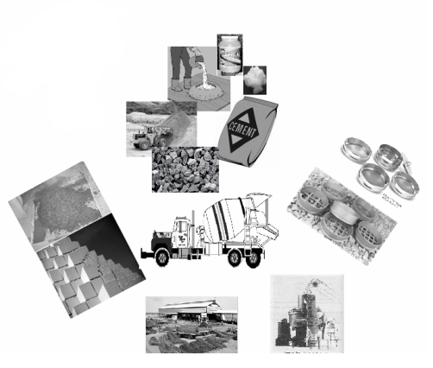
CONSTRUCTION:Design,Practices & Materials
“Myths & Realities ”
Sumangala Steel
1st TECHNICAL PRESENTATION
Trichy
29-11-2023
Er.C.KALYANASUNDARAM
Structural Engineer ,Chennai
9345391015

Slide 2

DREAM
(Myth ???)
DRAWINGS
REALITY..
CREATING THE BUILDING
-----FROM CONCEPT (TO) CONSTRUCTION
in today's scenario

Slide 3
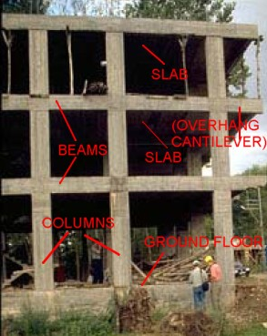
I.SIMPLIFIED STRUCTURAL DESIGN

Slide 4

For Engineers
STRENGTH OF MATERIALS
I,II, ……
THEORY OF STRUCTURES
I,II,III ……

Slide 5

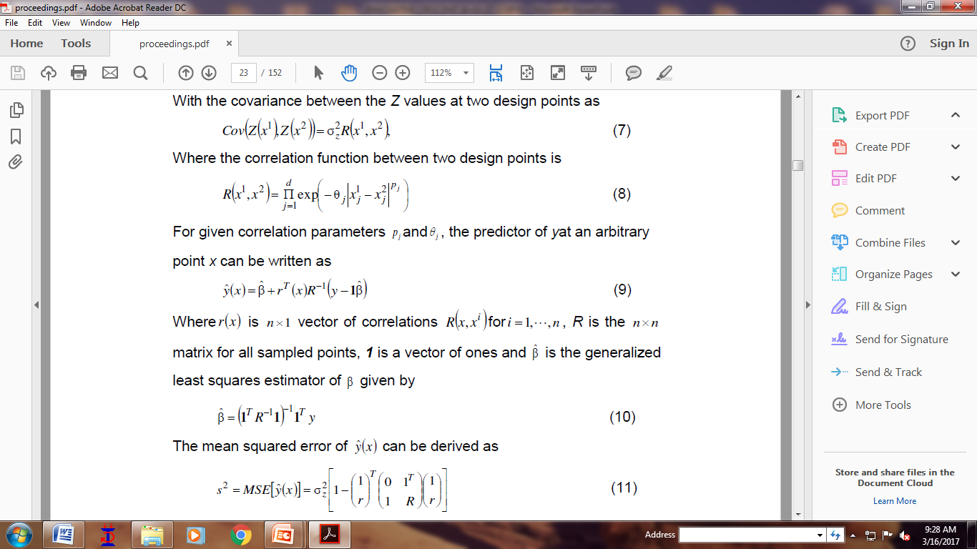
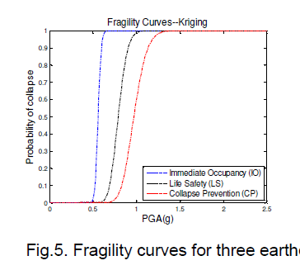
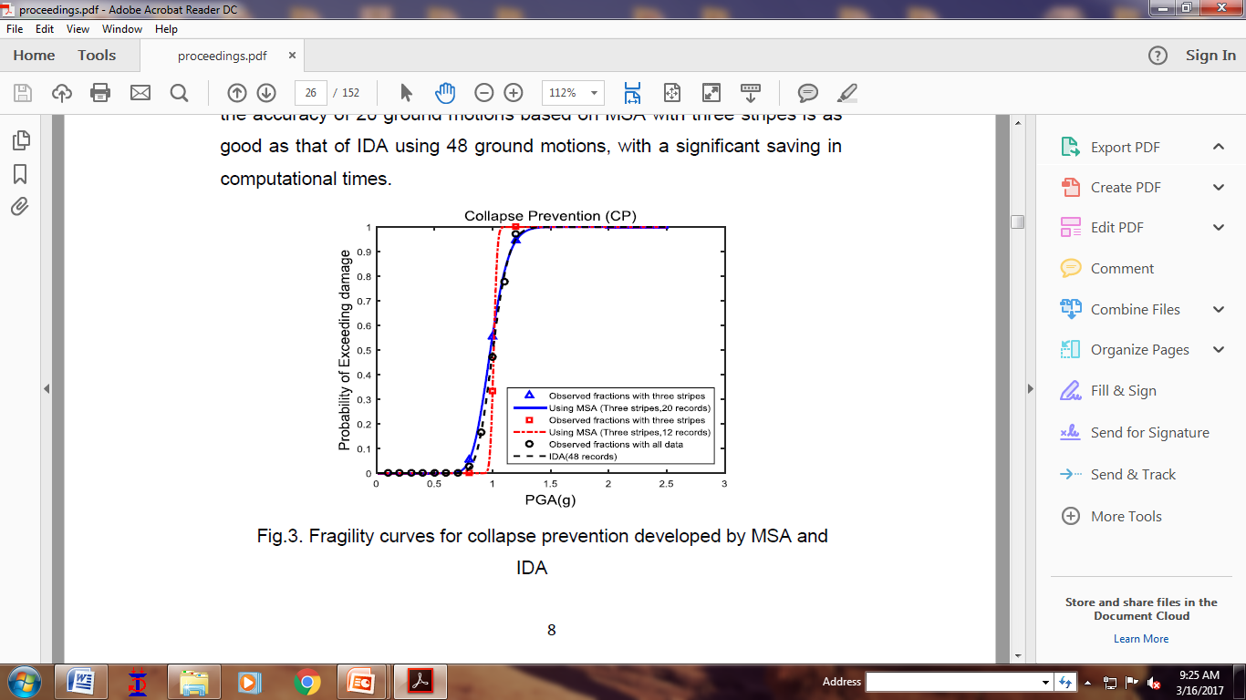
Laplace Transform Fourier Series Double & Triple Integration
ALL ENGINEERS TAUGHT ADVANCED MATHEMATICS
?????????
MYTH

Slide 6

ENGINEER (Vs) ADVANCED MATHS
?????????
REALITY

Slide 7


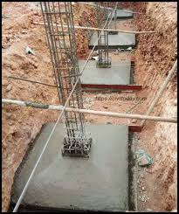
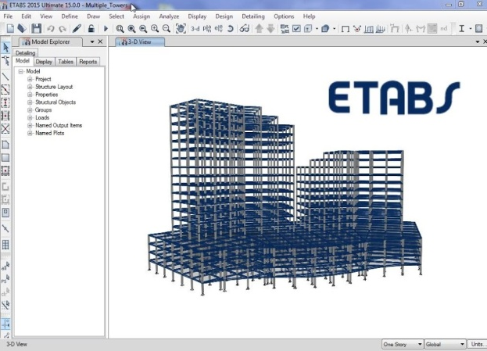
For whom this Presntn. is meant????
Father asking son (Civil Engineer Fresh from college) to ensure the structural adequacy to buy a Flat
Neighbour asking a Civil Engineer ( Fresh from college) to ensure the structural adequacy of the on going Foundation work
Designer has to presume size of beams, Columns etc., at the input stage in Design

Slide 8
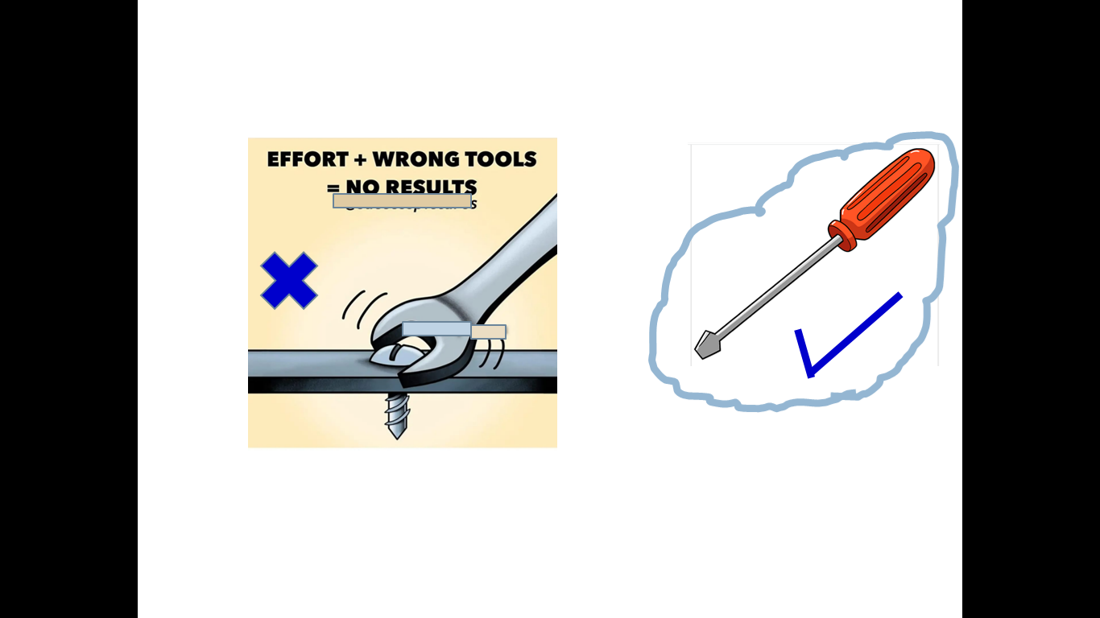
MYTH : Always Detail structural Design is needed
REALITY : Simplified Structural Design is
sufficient in many situations

Slide 9
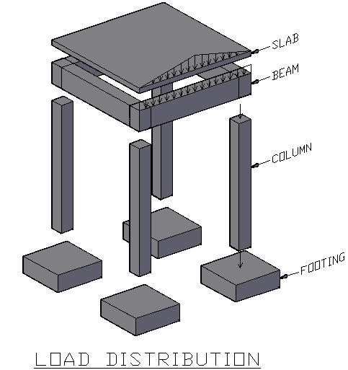

STRUCTURAL MEMBERS IN BUILDINGS
1. SLABS:
Slabs serve as floors or roofs
by bearing the loads applied to them.
2. BEAMS
Beams support the loads transferred
from slabs and walls.
3. COLUMNS
Columns bears the loads transferred
from beams andtransmit them to the
footings.
4. FOOTINGS
Footings distribute the loads transmitted from the columns into soil.

Slide 10
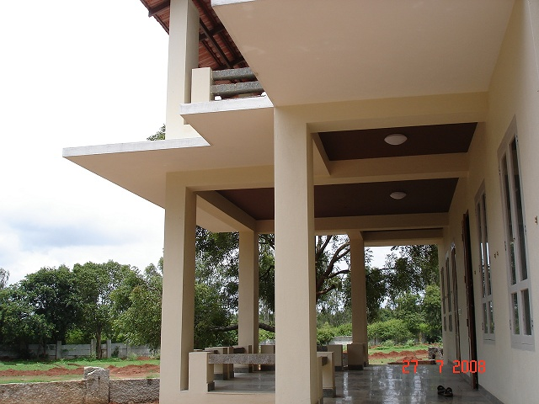
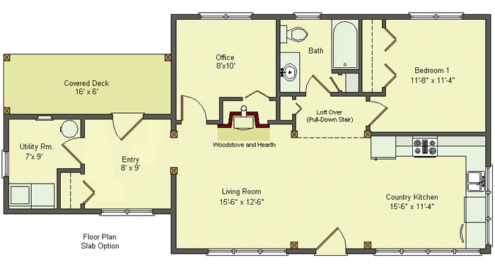
ASSESSMENT OF SLAB
How to calculate Thickness of slab ?

Slide 11
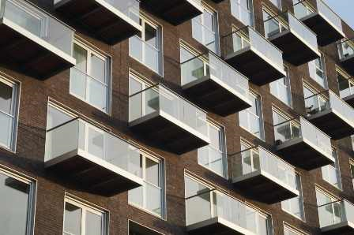
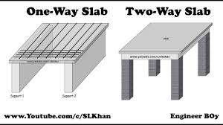
I – SLAB THICKNESS
Thickness of slab (Thumb-Rule)
if, l_{x} = 5m (Shorter Span)
Slab Thick = l_{x} x 3(coef.) = 15 cm.
Hence thickness to be provided
= 15cm.
For Cantilevers Slab
Thickness : Span /10
Span in metre | Thickness in “mm”
1.50 m | 150 mm
Span in metre | Thickness in “mm”
5.0 M | 150 mm

Slide 12
II- APPRAISAL OF BEAM
How to calculate size of Beam ?

Slide 13
EVOLVING SIZE OF BEAM
Concrete of Grade = M20
Steel = Fe500
Span = 6.0m
[7 (to) 8 cm depth per meter of span is assumed ]
Depth of beam for 6.0m span =
6.0 x 7.5 (coef.) = 45cm
Hence adopt depth of Beam as 45 cm (i.e.,450 mm)
Assume size of Beam as
(300x450) / (230x450)

Slide 14
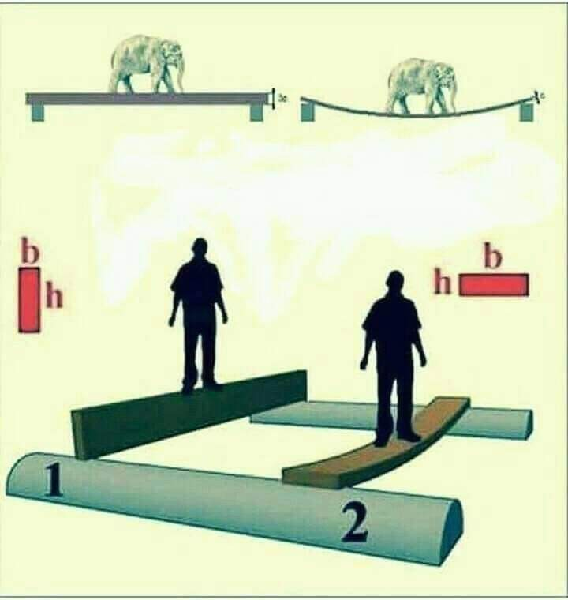
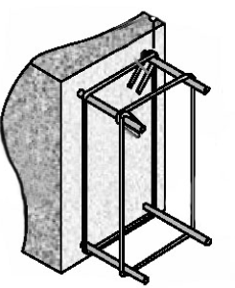

Slide 15
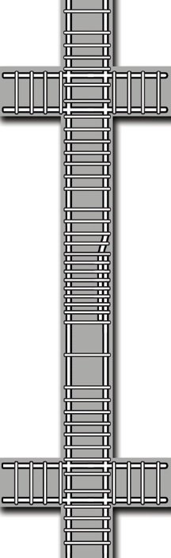
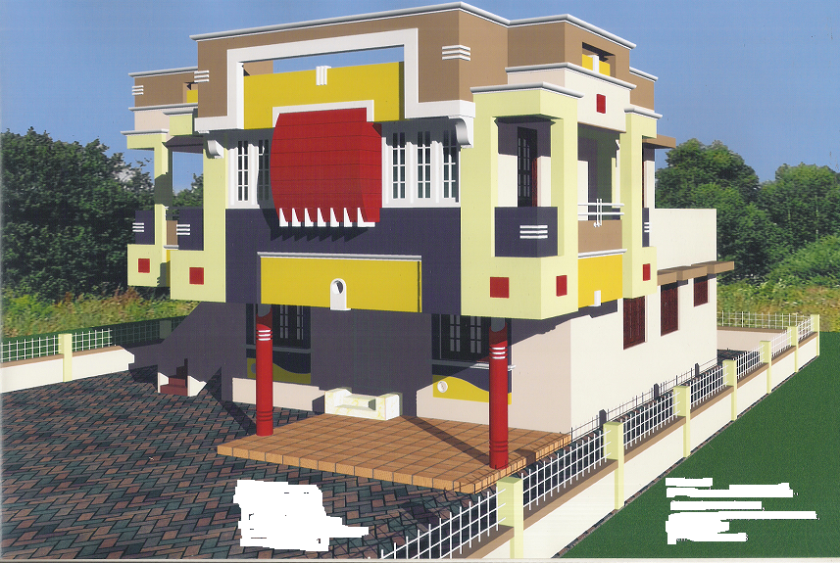
III-JUDGING COLUMN SIZE
How to Judge COLUMN size ??

Slide 16
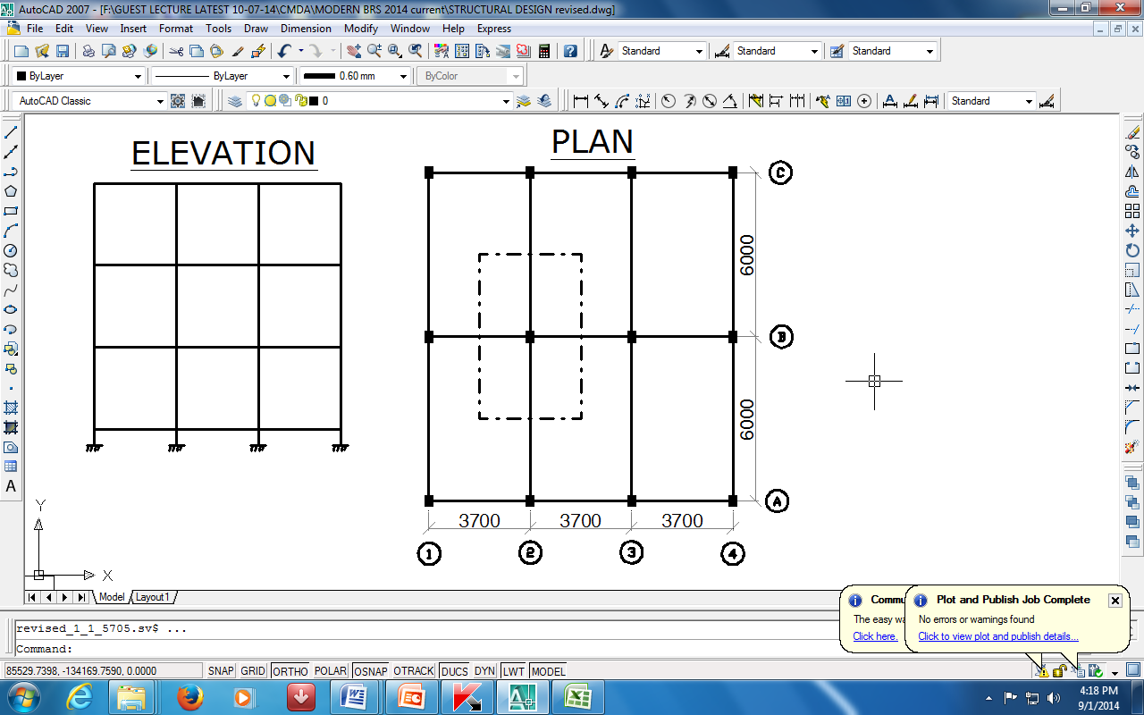
III COLUMN DESIGN APPROXIMATE APPROACH FOR FINDING OUT THE COLUMN FORCES
COLUMN POSITION
LOAD IN KN/M²
RESIDENT OFFICE BLDG. BLDG.
EXAMPLE
INTERIOR
12
14
B2,B3
EDGE
17
19
A2,A3,C2,C3
CORNER
22
24
A1,A4,C1,C4

Slide 17
DESIGN OF COLUMN B2
The building shown has three storeys .
i)CALCULATION OF LOAD ON COLUMN
Load influence area on column B2
(i.e.tributory area)
= (3.70/2 + 3.70/2) ( 6.0/2+ 6.0/2 ) = 22m²
Load on column B2 due to single storey
= 22.0 x 12 (coef.) = 264 KN
( Area)x (Coef. as per table-3)
Total load on column B2 = 792 kN
say 800 kN
[Due to 3 storey's (264 x 3)]

Slide 18
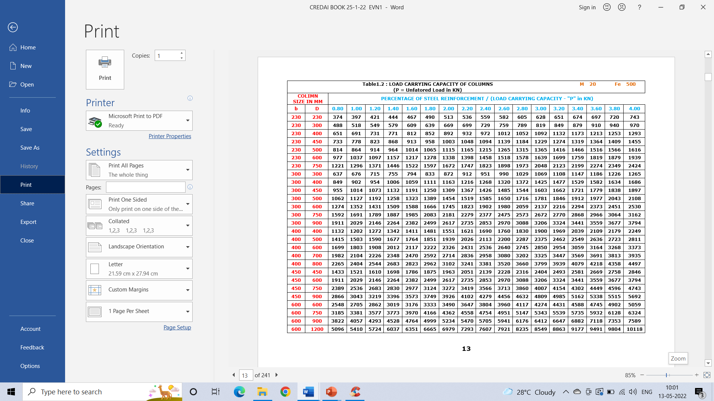

Slide 21
- without Table in Hand
2.20%

Slide 22
- without Table in Hand
Tips - without Table in Hand :
Load carrying capacity of Column
= Cross section Area in cm²
(with 2.20% reinft.)
2.20%

Slide 23
Safe load carrying capacity of column based on % of steel and known column section for various grade of concrete
Steel Grade → | Fe 500
Concrete Grade ↓
M20 | P=(3.27p + 8) bD/1500
M25 | P=(3.25p +10) bD/1500
M30. | P=(3.23p + 12) bD/1500
M35 | P=(3.21p + 14) bD/1500
M40 | P=(3.19p + 16) bD/1500
Where P is Axial Load carrying capacity of column in KN.
p = % of steel reinforcement ( say 2% is 2)
b = Breadth of Column in mm
D = Depth of Column in mm.

Slide 24
EVOLVING SIZE OF FOOTING
ISOLATED FOOTING

Slide 25
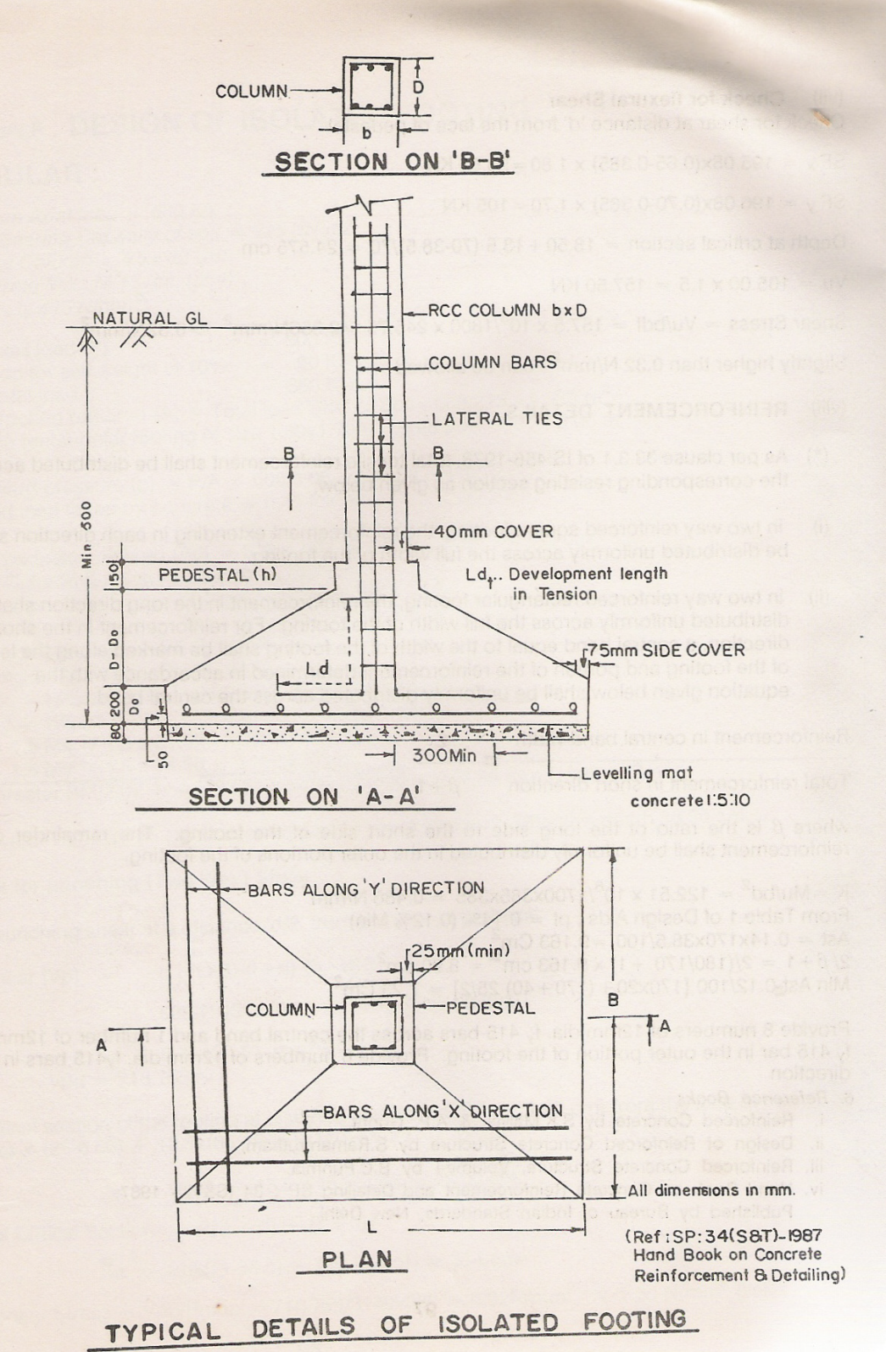
D
L
B

Slide 26
IV FOOTING DESIGN
Footings distribute the load transmitted
from the column into the soil. Size of footings depend on the type of soil on which the building rests.
S.B.C:
The safe bearing capacity ( S.B.C) of soils like clay is very less and
S.B.C. of soils like hard gravel soil is high
S.B.C. of soft / hard rock is very high.
Generally SBC of CLAY is assumed as = 100 KN/m²
SBC of COARSE SAND as = 150 KN/m²
& SBC of HARD GRAVEL as = 250 KN/m²
SBC of Soft Disintegrated Rock as = 300 KN/m²

Slide 27
FOOTING SIZE
Load on Column = “ 800 kN ”
Add 10% for footing wt. = 80 kN
TOTAL LOAD ON SOIL = 880 Ken
SBC of soil (say ) clay = 100 KN/m²
The concept of Footing Design :-
Pressure induced on the soil due to above
external load
should be < 100 KN/m²
Assume Size of Footing = (3.0 m x 3.0 m)
Hence , Pressure induced =
[ (880 Kn ) / (3.0 m x 3.0 m) = 98.0 KN/m²
and < 100 KN/m² (OK)
Size of Footing = (3.0 m x 3.0 m)

Slide 28
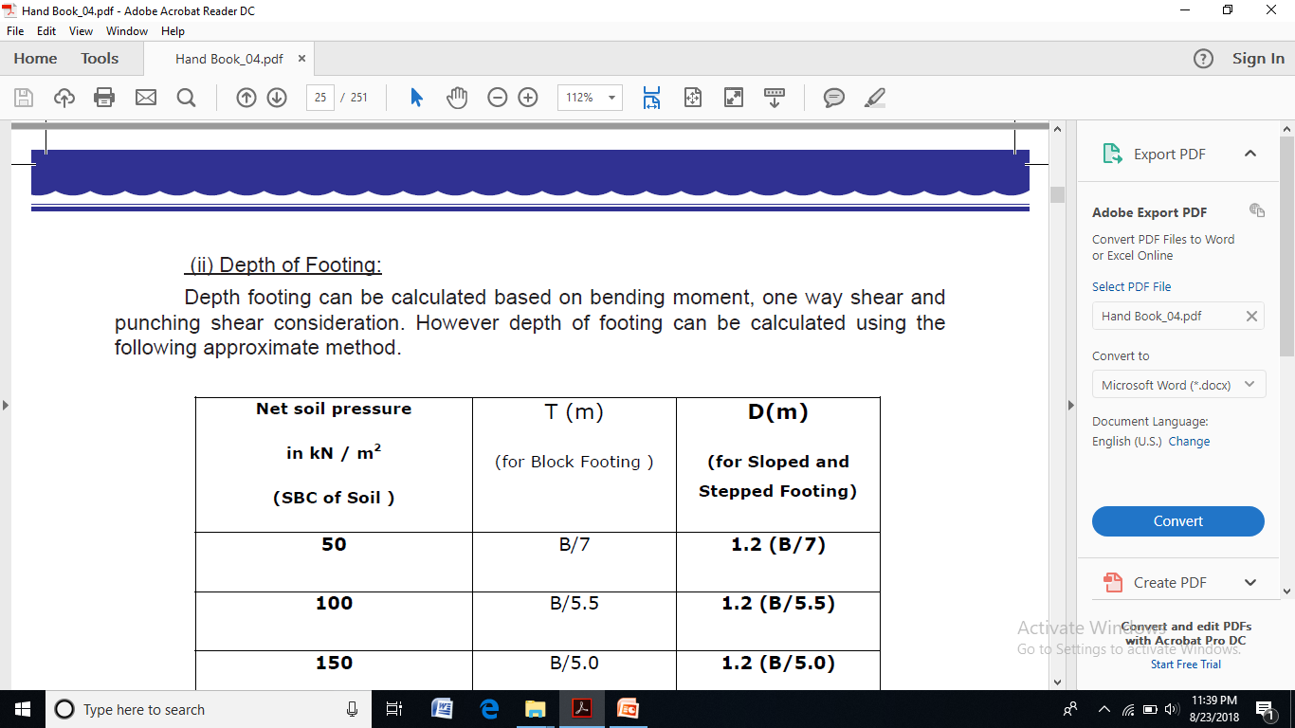

Slide 29
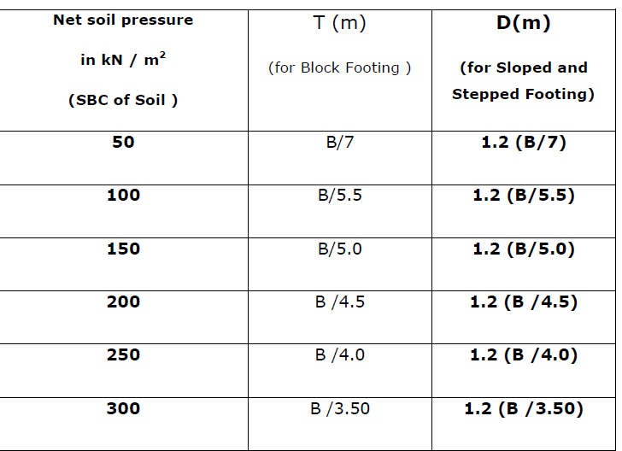
(3.0m/5)
= 0.60 m
or
600 mm
or
60cm
Where B = Size of footing in “m”
T or D = Total Thickness of Footing in “m”

Slide 30
Rough estimation of reinf. Steel in construction projects
SLAB 75 TO 100 Kg/m3 of concrete.
Beams 200 TO 225 Kg/m3
Columns 225 TO 350 Kg/m3
Footing 50 TO 75 Kg/m3
Grade Beam 100 TO 125 Kg/m3
Sunshade,Lintels,
Fins,Vertical Drops 50 to 75 Kg/m3

Slide 31
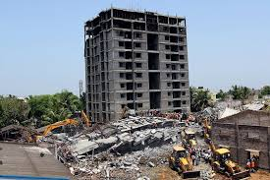
Case Studies
Case Study - 1
Collapse of a multistorey building

Slide 32
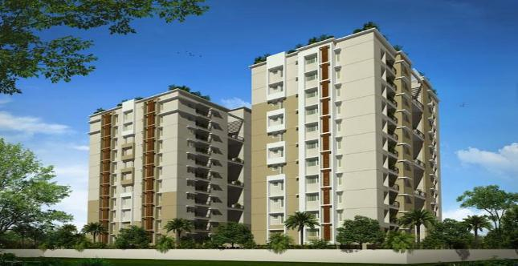

Slide 33

AD.BANNER FOR A HIGH RISE BLDG.

Slide 35
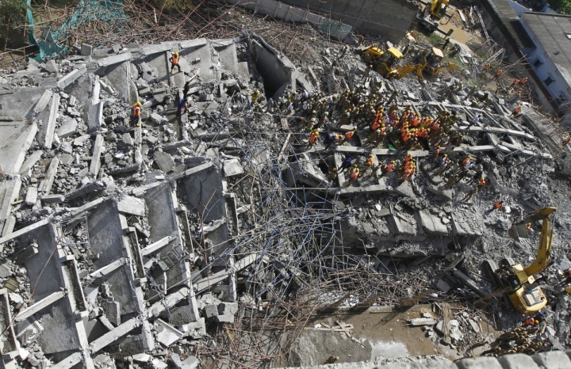

Slide 36
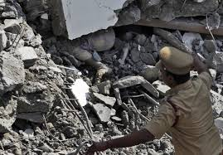

Slide 37
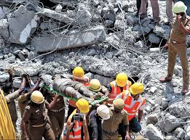

Slide 38
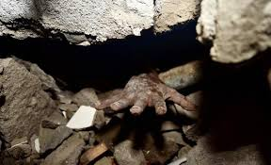

Slide 39
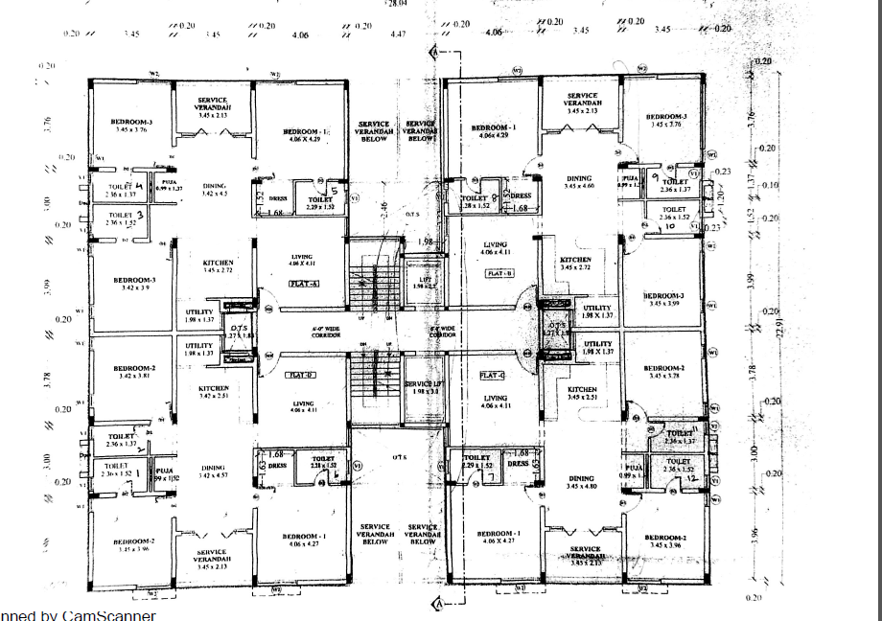

Slide 40
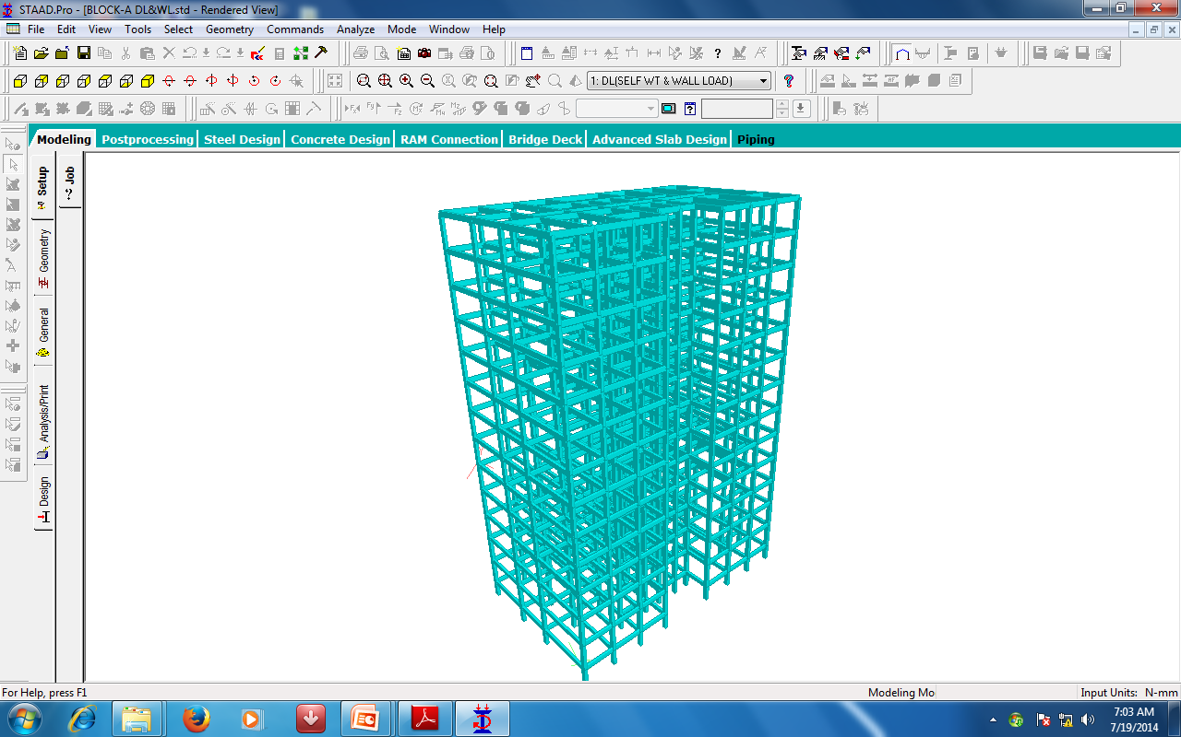
STAAD MODEL BLOCK A

Slide 41
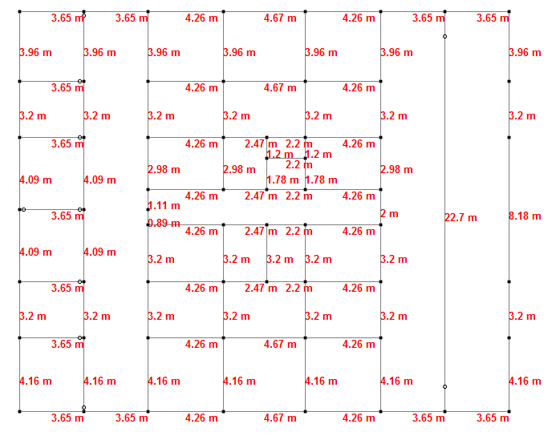

Slide 42
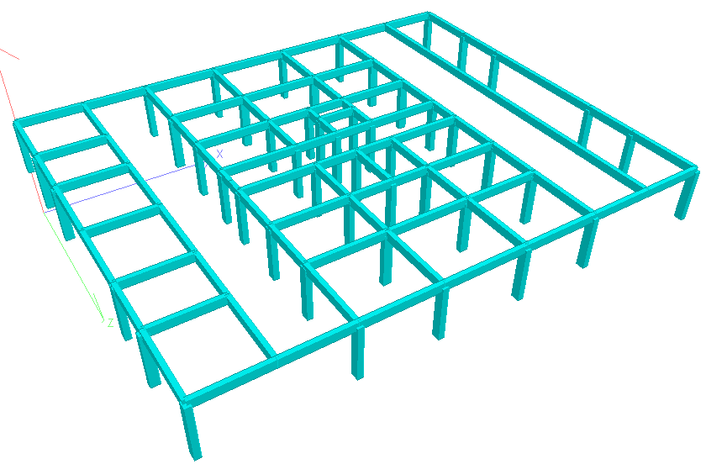

Slide 43
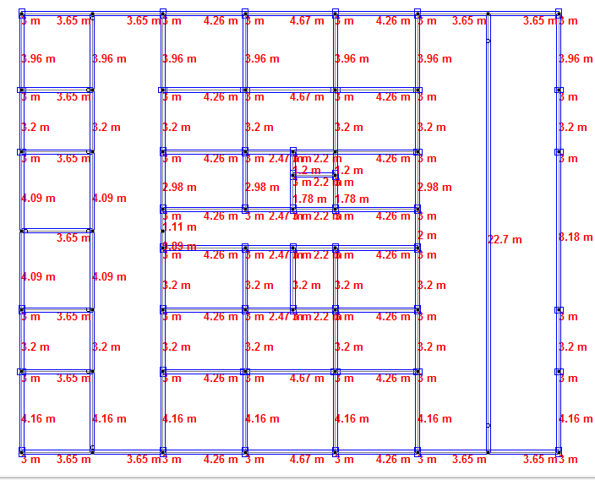

Slide 44
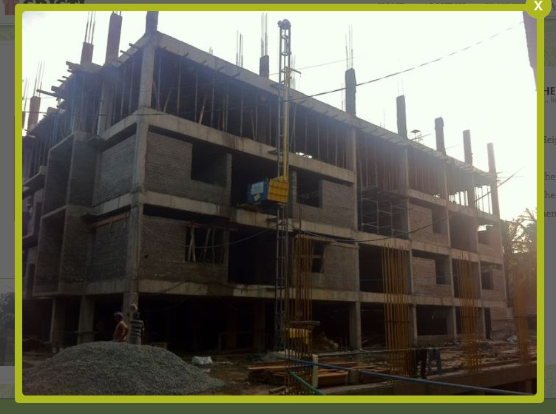

Slide 45
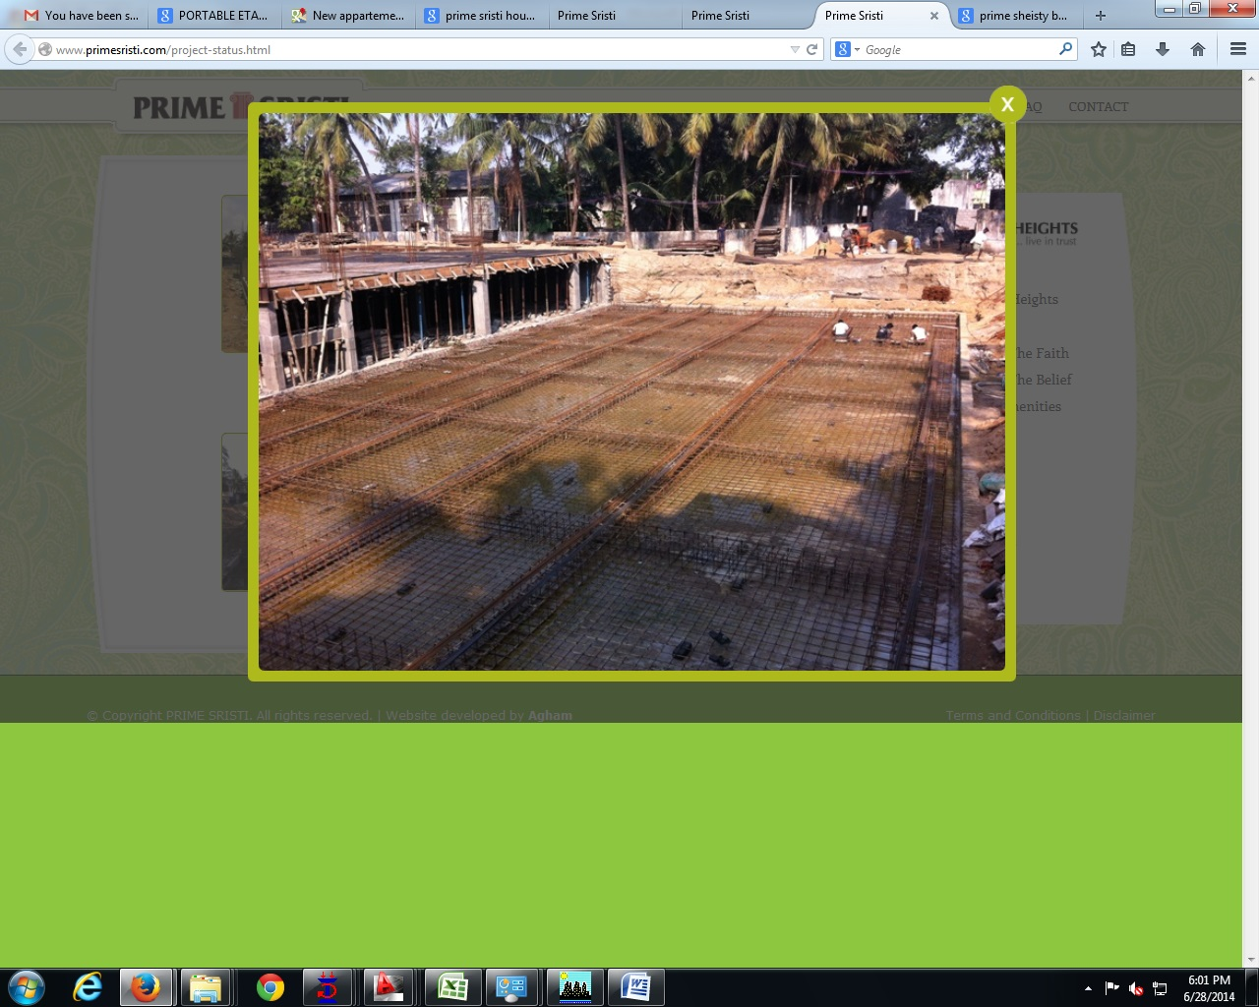
RAFT FOUNDATION

Slide 46

However the approximate methods and ready reckoners presented
here are to be used with care, since they are based on certain assumptions; forexample,
• The coefficients adopted for calculating column loads are based on the assumption that the building consist of Full wall on outer boundaries and Partition wall in interior portions. Suitable consideration is to be paid if it is not so.
Similarly for Staircase and Toilet portions suitable additional loads are to be added.
• The spans of beams assumed are small/moderate and are not very long to create signifigant moments in Columns. If significant moments are expected, rational additional loads may be considered to account for this.
######Hence it is advised to use these techniques with Civil Engineering Knowledge and Common sense

Slide 47




UNDERSTANDING MATERIALS
Not only the laymen,
but even some Civil Engineers themselves
are not capable of choosing the right materials whether Cement / Steel;
Rather they are also confused
because of commercial advertisements.

Slide 48
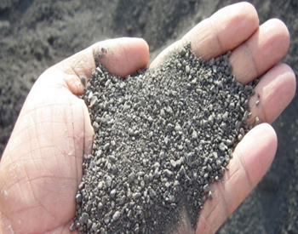
II M-SAND

Slide 49


Slide 50
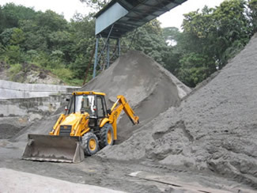
Crushed Stone Sand
(commercially called M-Sand)

Slide 51
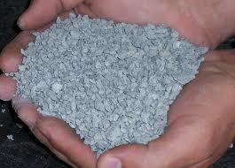
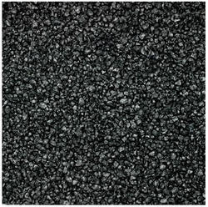
CS Sand (vs) M-Sand
IS 383:2016
(1) Crushed stone sand
- Fine aggregate produced by
crushing hard stone.
2) Manufacturing fine aggregate
(Manufactured Sand)
- Fine aggregate manufactured from
other than natural sources, by processing materials, using thermal or other process such as separation, washing, crushing and scrubbing.
CS -Sand
Copper Slag

Slide 52
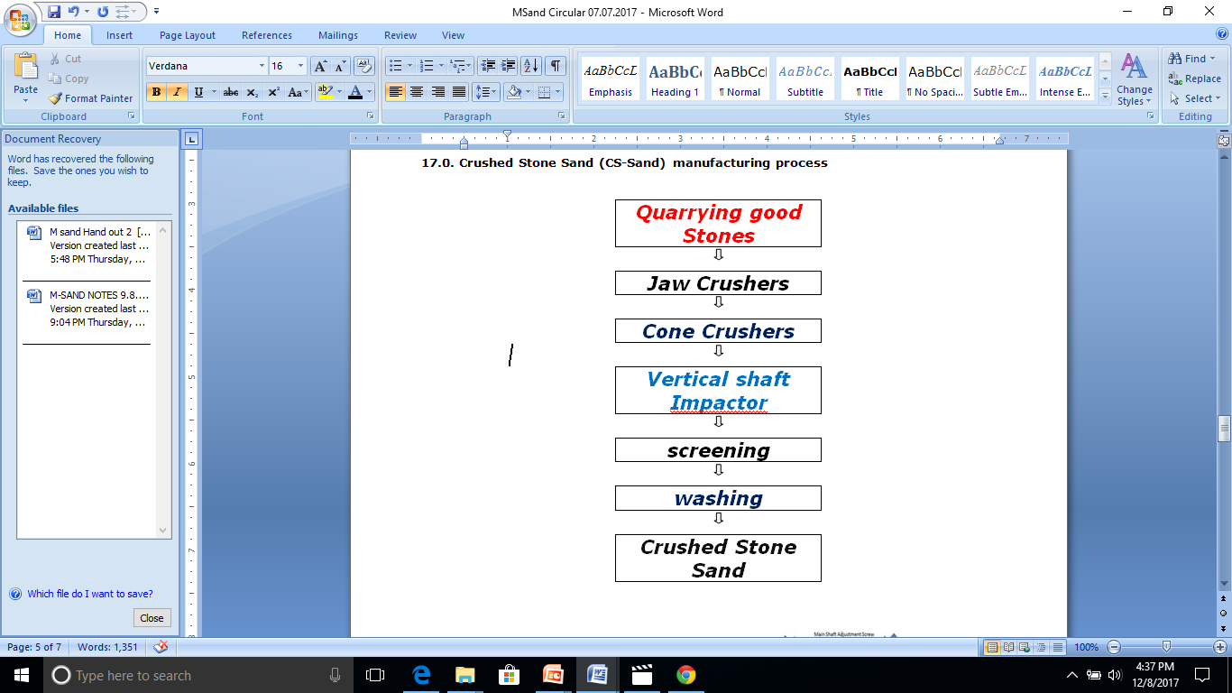
Crushed Stone Sand (CS-Sand) Manufacturing process

Slide 53
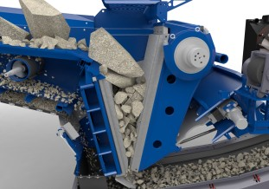
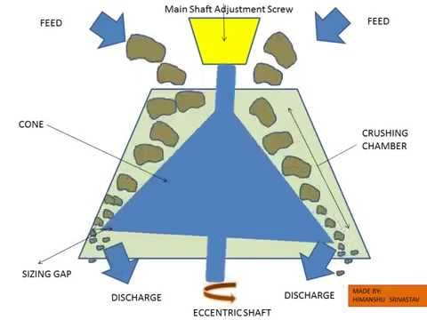
CRUSHERS
JAW CRUSHER
Cone Crushers

Slide 54
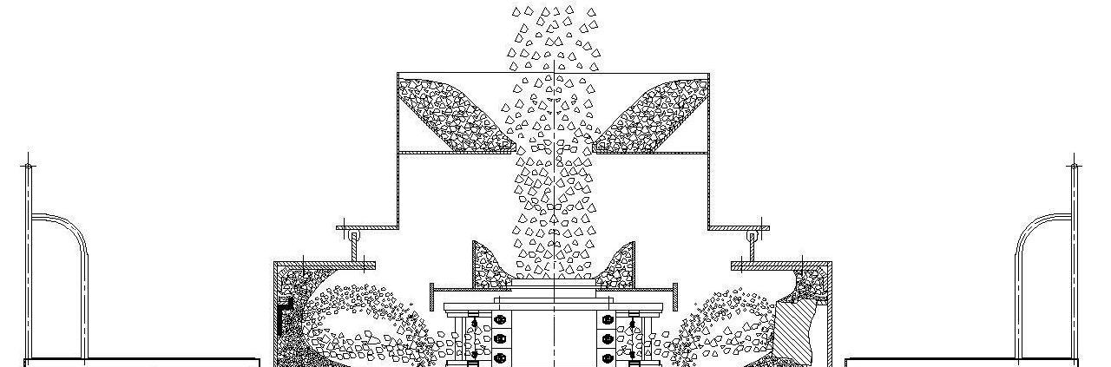
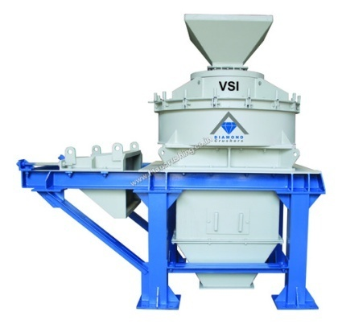
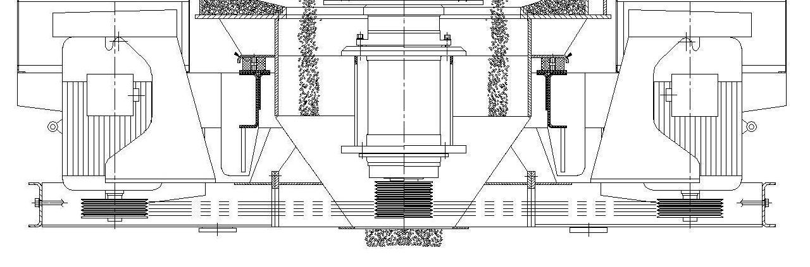
VSI (Vertical Shaft Impact Machine)
combined process of reducing coarser particles into finer particles &
shaping the fine particles by removing the flaky and weak edges.
Input Feed
Vertical Shaft Impact (VSI) Crusher

Slide 55
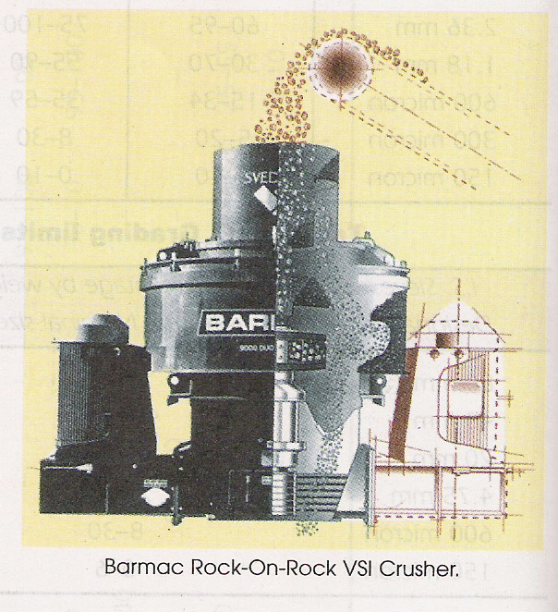
CSS from VSI Crushers
Good M-Sand - generated from V.S.I. Crushers
V.S.I. Crushers (Vertical Shaft Impact Crushers)
In this machine, particles are thrown at high speed
Particles colloid with each other &
shatter in cubical shape
- Due to Cleavage crushing / breaking of the particle, the surfaces are smoother

Slide 56
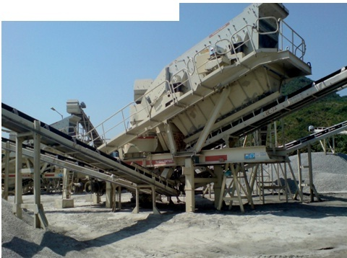
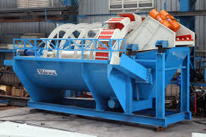
SCREENING & WASHING
M-Sand Screening Plant
M-Sand Washing Plant

Slide 57
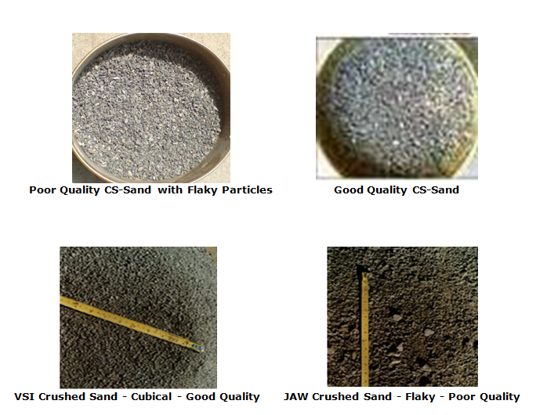
Good Quality M-Sand

Slide 58
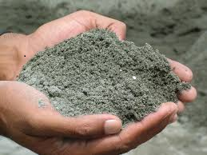

Field Tests on Crushed stone sand
Testing of CS-Sand by
“visual observation” and “rubbing with hand”
to assess the presence of Quarry dust

Slide 59

FIELD TEST FOR M-SAND
1) SHAPE TEST BY VISUAL OBSERVATION
Keen observation is to be made on handfulof M-Sand taken from the heap.
If it contains Rice flake shaped flaky particles in excess, it can be inferred that it has not been
manufrd. using appropriate
machineries especially not
with V.S.I.(Vertical Shape
Impactor),
and the Quality of M-Sand
is poor.

Slide 60

Field Tests on Crushed stone sand (Contd…)
Particles retained on 4.75mm and 2.36 mm can be verified visually for the particle shape.
Additionally, an image taken with the help of Mobile camera can be zoomed to verify the shape.

Slide 61

QUARRY DUST
The presence of excess quarry dust can be verified approximately by rubbing the M-Sand in-between our hands and observing the quantity of dust particles sticking in the palms.
Note : However it is better to find out the quantity of quarry dust present in M-Sand by washing it using water in 75 micron sieve
Particles less than 75 micron (Micro fines in M -Sand)
Though IS 383:2016 accepts 15% as upper limit for presence of Micro fines, according to Industry experts it is advisable to limitthis upper value to 7%.
In P-Sand, amount of fine dust (i.e., fine particles
finer than 75 microns )shall not exceed 5% by weight.
(IS 1542-1992,Clause 4.3a)

Slide 62


Particle Size Distribution by Sieve Analysis

Slide 63
Sieve Analysis requirements of Sand as per IS: 383 / 2016
IS Sieve size | Percentage passing for
 | Grading Zone I | Grading Zone II | Grading Zone III | Grading Zone IV
4.75 mm | 90-100 | 90-100 | 90-100 | 95-100
2.36 mm | 60-95 | 75-100 | 85-100 | 95-100
1.18 mm | 30-70 | 55-90 | 75-100 | 90-100
600 micron | 15-34 | 35-59 | 60-79 | 80-100
300 micron | 5-20 | 8-30 | 12-40 | 15-50
150 micron | 0-10 | 0-10 | 0-10 | 0-15

Slide 64


PLASTERING COMPLAINTS

Slide 65
Three easy steps to make quality Plastering
a) Mixing cement and Quality M-Sand in proper
proportions
b) Good workmanship
c) Curing for required number of days
Three precautionary steps which enables to assess the
quality of M sand for Plastering works
a ) M- Sand for Plastering works (P Sand) shall not
contain flaky substances (shape similar to Rice
flakes) in excess
b) Quarry dust or crusher micro fines (<75 microns)
shall not be Present in excess over the prescribed
limits
c) Mica particles shall not be present in excess over
the prescribed limits

Slide 66



(A) POINTS TO BE FOLLOWED BEFORE STARTING THE PLASTERING WORK
(1) Make sure that the
constructed brick wall is cured for atleast 7 (OPC cement) to 10 (PPC cement) days before starting the plastering work.
(2) Make sure that the holes for the props provided during
the construction work are closed properly.
(3) The brick wall surface should be thoroughly cleanedbefore starting the plastering work.

Slide 67


(B) POINTS TO BE FOLLOWED DURING
THE PLASTERING WORK
(2) The plasticizer meant specially for the
cement mortar (eg: FOSROC-CEBEX112 etc.,)
should be made available as solution
by dissolving it into the water
(1)The dry mix should be prepared by mixing
Cement and M-Sand thoroughly in required
proportion (Cement Mortar 1:5 etc.,)
using measuring box.
Dosage:
Plasticizer – (100 to 200) ml & Water -10 Litre.

Slide 68

(3) The above solution should be mixed well
with the dry mix already prepared to the desiredworkability. This mixed mortar should be usedwithin 30 minutes.
(4) To achieve uniform Plastering thickness
of the coating place the billets (12 mm thick)
at 1 m intervals on the surface of wall
to be plastered.

Slide 69


(5) The plastering mortar of size 15cmx15cm
should be made on brick work surface
at 2m intervals which enables to attain uniform
plastering all over the wall.
(6) At the point where the new plastering work
joins the old plastering work, the edge of the
old plastering should be scraped off and sprayed
with the cement slurry.

Slide 70


(7) The first coat of plastering should be
troweled well with vital Hand Pressure using
plastering trowel. Then the overall plastering
should be levelled by pressing using strong
wooden bar and wooden plank with good force.
(8) The final coat of plastering should be applied
on surface from top to bottom, while the first coat
is wet, and the plastering thickness should
not exceed 12mm. The plastering surface should
be finished without undulations by trowelling
with required good pressure.

Slide 71


(9) If grooves and plaster border are to
be provided, then it should be made while the
plastering surface is still under wet condition.
(10) When skirting lines are to be cut on surface
in order to fix Electrical Junction Box,
Fan box etc., it should be done properly
without damaging the plastering.

Slide 72


(11) Make sure that the billets which were
used to attain required plastering thickness
are removed.
(12) The Scattered mortars on the wall, floor,
boxes and iron sheets etc., should be cleaned,
at the of end of Every day as soon as the
plastering work is completed.

Slide 73


(C) POINTS TO BE FOLLOWED AFTER
FINISHING THE PLASTERING WORK
(1) Date of Completing the plastering work
should be marked using paint properly and should
not get erased when water curing is done.
(2) The plastered wall surface should be cured
with water for 7 days (OPC Cement) to
10 days (PPC Cement) at least.

Slide 74

III STEEL

Slide 75

STEEL

Slide 76
Properties of Various Types of Steel
(Codal Requirements)
IS 1786-2008
TYPE |  | YIELD STRESS (N/mm2 ) (Min.)
MILD STEEL | MS (Grade I) | 250
HIGH STRENGTH DEFORMED BARS | Fe 415 (Fe 415 D) (Fe 415 S) | 415
 | Fe 500 (Fe 500D) (Fe 500S) | 500
 | Fe 550 (Fe 550D) | 550
 | Fe600 | 600

Slide 77



STEEL(History)
60’^{s} - ROUND PLAIN STEEL BARS
(Mild Steel)
70’^{s} TO 90’^{s} - TOR STEEL BARS
THIS DECADE- TMT STEEL BARS

Slide 78
Thermo Mechanically Treated bars (TMT bars)
QST bars in many other countries
is known as TMT bars in India
QST : Quenching & Self Tempering
Advantages:
*Strength √
*Ductility √
*Bendability √
*Weldability √

Slide 79


TMT STEEL BARS MANUFACURING
‘Quenching & Tempering’ (Q & T) technology
1.Quenching
2.Self Tempering
3. Atmospheric Cooling
BILLETS
Notes:
TMT STEEL BARS MANUFACURING

Slide 80

TMT STEEL BARS MANUFACURING
‘Quenching & Tempering’ (Q & T) technology
The rolled hot bar of given size at the right speed and temperature enters Quenching Box
1.Quenching Right quantity of water at right temp. and pressure is sprayed to quench the Red-Hot Steel
Notes:
TMT STEEL BARS MANUFACURING

Slide 81



TMT STEEL BARS MANUFACURING
2.Self Tempering
On leaving Quenching Box ,the outer shell is cool as compared to the still hot core,which continues to radiate heat.This heat migrate towards the surface self -tempering the outer layer into martensitic there by giving the bar the improved deformity.
Notes:
TMT STEEL BARS MANUFACURING

Slide 82

TMT STEEL BARS MANUFACURING
3. Atmospheric Cooling
Th bars are allowed to cool on the Cooling Bed naturally.The Continued radiation and migration of heat from the core to the surface turns the austenitic core into ductile ferrite- pearlite structure,
Notes:
TMT STEEL BARS MANUFACURING

Slide 83
TMT STEEL BARS MANUFACURING
Thus a Hard Outer Layer with a ductile soft core
is produced
Fine combination of a strong outer rim (tempered martensite)
and
A ductile core (ferrite-pearlite)
The end result - strength as well as ductility.
Notes:
TMT STEEL BARS MANUFACURING

Slide 84

SIMPLE TEST-TO IDENTIFY GENUINE TMT BARS
CUT THE TMT BAR
POLISH THE CROSS SECTION WITH EMERY PAPER
(IF POSSIBLE GRIND IT)
SOAK IT IN NITROL SOLUTION
(5% NITRIC ACID, 95% ETHYL ALCOHOL)
UNIFORM TEMPERED MORTENSITE PERIPHERY
& INNER SOFTER CORE - GOOD TMT

Slide 85

*UNIFORM TEMPERED MORTENSITE PERIPHERY & INNER SOFTER CORECOCOPY
* FOR GOOD TMT, HARDENED PERIPHERY WILL BE
15 % TO 30% (max) of cross section area.
*HIGHLY OVER QUENCHED BAR
HARDENED PERIPHERY IS 60% OF CROSS SECTION
*UNDER QUENCHED BAR
HARDENED PERIPHERY IS ONLY 10% OF CROSS SECTION
*NON UNIFORM QUENCHED BAR

Slide 86




POLISH THE CROSS SECTION WITH EMERY PAPER
=>
SOAKING IN NITROL SOLUTION
(5% NITRIC ACID, 95% METHYL / ETHYL ALCOHOL)
UNIFORM TEMPERED MORTENSITE PERIPHERY
& INNER SOFTER CORE
- GOOD TMT
=>

Slide 87
THREE ALTERNATE PROCESSES TO MANUFACTURE STEEL
Process 1
IRON ORE + COKING COAL → BLAST FURNACE → PRIMARY STEEL
Process 2
IRON ORE + THERMAL COAL → Rotary KILN→ SPONGE IRON
SPONGE IRON (>50%) + SCRAP → INDUCTION FURNACE → SECONDARY STEEL (SPONGE IRON BASED)
(Removal of Phosphorous, if present, is impossible and sulphur very difficult from sponge iron with Induction Furnace and can only be diluted)
Process 3
SCRAP >80 TO 99 % + SPONGE IRON >1 TO 20%
→ INDUCTION FURNACE → SECONDARY STEEL (SCRAP BASED)
Steel bars produced by the above processes must conform to Bureau of Indian Standards
Notes:
TMT STEEL BARS MANUFACURING

Slide 88
(Codal Requirements)
IS 1786-2008
Mech. Properties of Various Types of Steel
TYPE |  | YIELD STRESS (N/mm2 ) (Min.) | ULTIMATE TENSILE STRESS (TENSILE STRENGTH-Min.) (N/mm2) | ELONGATION PERCENTAGE
MILD STEEL | MS (Grade I) | 250 | 410 | 23.00 % | IS 432(part 1)
HIGH STRENGTH DEFORMED BARS | Fe 415 (Fe 415 D) (Fe 415 S) | 415 | Not Less than 485 (500) | 14.50 % (18.00%) (20.00%) | IS 1786-2008
 | Fe 500 (Fe 500D) (Fe 500S) | 500 | Not Less than 545 (565) | 12.00 % (16.00%) (18.00%) | IS 1786-2008
 | Fe 550 (Fe 550D) | 550 | Not Less than 585 (600) | 10.00 % (14.50%) | IS 1786-2008
 | Fe600 | 600 | Not Less than 660 | 10.00% | IS 1786-2008

Slide 89
Chemical composition of Various Types of Steel
 |  | Fe 500 | Fe 500D | Fe 550 | Fe 550D
 | Carbon | 0.30 | 0.25 | 0.30 | 0.25
 | Sulphur | 0.055 | 0.04 | 0.055 | 0.04
 | Phosphorous | 0.055 | 0.04 | 0.050 | 0.04
 | Sulphur & Phosphorous | 0.105 | 0.075 | 0.100 | 0.075
 | Carbon Equivalent (C,Mn,Ni,Cr……) | 0.53 (when micro/low alloys are used)
 |  | 0.42 (when micro/low alloys are not used)

Slide 90
Carbon Content in Steel
STEEL is an alloy of Iron & Carbon
Aim is to achieve low Carbon Steel
Some minimum Carbon content is essential to achieve the required Strength
Excess Carbon content reduces Ductility & weldability

Slide 91
Sulphur Content in Steel
Why TITANIC ship sunk ???
High Sulphur in Steel –Brittleness
Interesting Example
Since Sulphur content in the steel walls and frames in bottom of ship were high (beyond Permissible limit ) the steel frames were broken when hit against icebergs.

Slide 92
Right choice of steel grade
TYPE | YIELD STRESS (N/mm2 ) (Min.) | ELONGATION PERCENTAGE | ULTIMATE TENSILE STRESS (TENSILE STRENGTH-Min.) (N/mm2)
Fe 415 | 415 | 14.50
Fe 500 (Fe 500D) √√ | 500 | 12.00 % (16.00%) | Not Less than 545 (565)
Fe 550 (Fe 550D) | 550 | 10.00 % (14.50%) | Not Less than 585 (600)
For Ordinary Buildings :Fe500/Fe550
For EQ /High rise Buildings :Fe500 D/Fe550D
Testing –Very Important for “D” Grade steel (Ductility &
Chem. Comp.
S & P)
Factory visit is recommended for Engineers

Slide 93

Stirrups(Rings)
Right choice of steel grade
Vus =(0.87 fy Asv d) / (Sv)
fy = Characteristic strength of stirrups which shall not be taken greater than 415 N/mm2 IS 456-2000, Clause 40.4
According to IS 456 the max. allowable shear stress for even Fe550 is limited to 415 only.
Hence practically the same detailing (dia.& Spacing) as 415 is to be used.
But for 550 individual ductility(% of elongation) is less compared to that pf 415.
So better is 415
But due to non availability of 415 we can use 500D as a right choice for rings

Slide 94










Stirrups(Rings)
Stirrups has to hold the main bars correctly in position.
Since Rings has to ensure a monolithic connection between Concrete and steel(being a composite structure) its crucial to correctly bend the bars at 90 and 135 deg. This enhances the structural integrity of the composite element.

Slide 95
IS THERE ANY STEEL CALLED EARTHQUAKE PROOF STEEL ???

Slide 96

1. ANALYSIS for LATERAL LOAD
F = Coef. x W
= A_{h} x W
F = Coef. x W
= A_{h} x W
LATERAL LOAD will require Additional steel

Slide 97




Z

Slide 98



2. DETAILING FOR EARTHQUAKE RESISTANT CONSTRUCTION
ADDL. MAIN REINFT. DUE TO ADDL LATERAL EQ LOAD
EXTRA DEVEP LENGTH
CLOSELY SPACED RINGS
Individual Bar Ductility (say 500D)
&
Joint Ductilty (Closely spaced Rings & extra Dev length Bending at ends)
Both are important

Slide 99





ADDITIONAL COST (STEEL)
FOR ZONE III
ADDITIONAL STEEL REQUIRED
= 15% TO 20% Extra
ADDITIONAL COST
FOR EARTHQUAKE
DESIGN PROVISIONS
8% TO 10% OF TOTAL COST BUILDING

Slide 100
CORROSION OF STEEL
*Corrosion of steel-
due to Chloride ion effect or Carbonation

Slide 101



Corrosion of steel bars
Column
slab
Beam
Corrosion cracks (vs) Structural Cracks

Slide 102

Carbonation
pH of concrete reduces (from 13.5 to 8.5),
the degree of alkalinity of Concrete
Loss of Alkalinity accelerates rusting of steel

Slide 103
REASONS FOR CORROSION
Corrosion will not takes place if steel bars are properly embedded in dense concrete.
Corrosion takes place when moist air penetrates into concrete.
TO AVOID CORROSION
Provide Good Quality Concrete
Proper Protection Cover
Good compaction –Dense concrete
Good quality water (free from Chloride and Sulphate)

Slide 104
BLUE STEEL VS OXIDISED BROWN STEEL
Myth:
Is STEEL FOUND BROWN (OXIDISED) IN COLOUR INFERIOR???
FACT:
IT IS A NATURAL PROTECTIVE LAYER

Slide 105

IV WATER QUALITY

Slide 106


WATER QUALITY
Potable water (water fit for drinking) is generally considered fit for construction.
PERMISSIBLE LIMITS FOR CHEMICALS IN WATER
(IS 456 – 2000)
Maximum permissible limit
1. Organic 200 mg/litre
2. Inorganic 3000 mg/litre
3. Sulphate (as SO₄) 400 mg/litre
4. Chlorides (as Cl₂) 2000mg/litre for plain concrete work 500 mg/litre for RCC work.
5. Suspended matter 2000mg/litre

Slide 107


WATER QUALITY (Contd..)
The pH value of water shall generally be not less than 6.
pH of Water can be found out using litmus paper.

Slide 108


pH Meter
TDS Meter

Slide 109
V CEMENT

Slide 110



TYPES OF CEMENT
Ordinary Portland Cement –33Gr 43 Gr, 53 Gr
Portland Pozzolona Cement (Fly Ash…)
Portland Slag Cement, etc.
Sulphate Resisting Portland Cement

Slide 111

Ordinary Portland Cement
Minimum Compressive Strength of
Cement Mortar in N/mm²
( IS 269-2015)
Type of Cement | INI SET | 3 day | 7 day | 28 day MIN | 28 day MAX
OPC – Grade 33 | ½ hr | 16 | 22 | 33 | 48
OPC – Grade 43 | ½ hr | 23 | 33 | 43 | 58
OPC – Grade 53 | ½ hr | 27 | 37 | 53 | -
OPC – Grade 43S | 1 hr | 23 | 33 | 43 | -
OPC – Grade 53S | 1 hr | 27 | 37 | 53 | -
ENNORE SAND USED IN LAB
Why 7 days 28 days
Notes:
111

Slide 112



Different grades of OPC
HISTORY

Slide 113
Ordinary Portland Cement
Minimum Compressive Strength of
Cement Mortar in N/mm²
( IS 269-2015)
Type of Cement | INI SET | 3 day | 7 day | 28 day MIN | 28 day MAX
OPC – Grade 33 | ½ hr | 16 | 22 | 33 | 48
OPC – Grade 43 | ½ hr | 23 | 33 | 43 | 58
OPC – Grade 53 | ½ hr | 27 | 37 | 53 | -
OPC – Grade 43S | 1 hr | 23 | 33 | 43 | -
OPC – Grade 53S | 1 hr | 27 | 37 | 53 | -
ENNORE SAND USED IN LAB
Why 7 days 28 days
Notes:
113

Slide 114
Portland Pozzolana Cement(PPC)
Minimum Compressive Strength of
Cement Mortar in N/mm²
)
Type of Cement | IS CODE | 3 day | 7 day | 28 day MIN
PPC (fly Ash) | IS 1489-2015 | 16 | 22 | 33
PSC (Slag) | ½ hr | 16 | 22 | 33
SRC | ½ hr | 16 | 22 | 33
Notes:
114

Slide 115


Which grade of Cement to use – (General Recommendation)
OPC (53 grade) cement - Concreting works
PPC Cement - Plastering works

Slide 116


Precaution to be taken while using OPC 53 - Early Curing
When 53 Gr OPC is used,
Curing to be started within 4 to 5 hrs of Concreting

Slide 117

Myth:- Cement quantity for a particular grade of Concrete can be reduced when we go for higher grade
(like Gr – 53) Cement.
Fact:- No.
Cement quantity cannot be reduced
(for a particular concrete strength)
But there will be faster rate
of development of strength
The advantage of early removal of shuttering can be well utilized

Slide 118
Portland Pozzolana Cement(PPC)
Minimum Compressive Strength of
Cement Mortar in N/mm²
)
Type of Cement | IS CODE | 3 day | 7 day | 28 day MIN
PPC (fly Ash) | IS 1489-2015 | 16 | 22 | 33
PSC (Slag) | ½ hr | 16 | 22 | 33
SRC | ½ hr | 16 | 22 | 33
Notes:
118

Slide 119




Different grades of CONCRETE

Slide 120


CONSTRUCTION COMEDY
LACK OF COMMON SENSE

Slide 121

CONSTRUCTION -COMEDY

Slide 122


CONSTRUCTION -COMEDY

Slide 123


CONSTRUCTION -COMEDY

Slide 124


CONSTRUCTION -COMEDY

Slide 125


Slide 126


CONSTRUCTION -COMEDY

Slide 127


CONSTRUCTION -COMEDY

Slide 128


Slide 129


CONSTRUCTION -COMEDY

Slide 130


Slide 131


Slide 132


Slide 133


Slide 134


Slide 135


Slide 136



Slide 137


Slide 138


Slide 139


Slide 140


Slide 141


CONSTRUCTION -COMEDY

Slide 142


Slide 143


Slide 144


Slide 145



Slide 146

CREATING THE BUILDING
-----FROM CONCEPT (TO) COSTRUCTION
AFTER MEETING WITH CLIENT
CONCEPT SKETCH
Interaction
Thank You
AFTER STRUCTURAL DESIGN
AFTER
COSTRUCTION
C.KALYANASUNDARAM
Structural Engineer Chennai
9345391015

